Slide 1
Introduction to SOLID Principles

Slide 2
Objectives of this session
What is Object Oriented Design?
Why Object Oriented Design?
Object Oriented Design Principles.

Slide 3
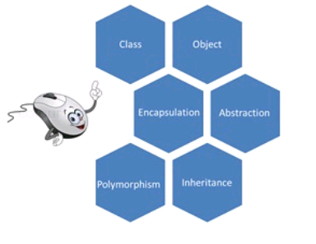
Targeted Audience Level
Who have at least a basic idea of Object oriented programming.
Who can talk about the basic pillars of object oriented programming

Slide 4
Object Oriented principles
Encapsulation
Inheritance
Polymorphism
Abstraction

Slide 5
What is Object oriented Design?
It’s a process of planning a software system where objects will interact with each other to solve specific problems.
The saying goes,
"Proper Object oriented design makes a developer's life easy, whereas bad design makes it a disaster."

Slide 6
What is Object oriented Design? Cont.…
We learnt words and how to assemble the alphabets to make those meaningful words.
Along with that, you learned some basic grammar to assemble the words into sentences.
For example, you had to maintain tenses, and you had to use prepositions, conjunctions, and others properly to create grammatically correct sentences. Say, a sentence like the following:
"I" (pronoun) "want" (Verb) "to" (Preposition) "learn" (Verb) "OOD" (Noun)
You see, you are assembling the words in some order, and you are also choosing the correct words to end up with a sentence that has some meaning.

Slide 7
What is Object Oriented Design Principles?
This is analogous to Object Oriented Principles.
OOP says about the basic principles and the core ideas to do Object Oriented programming.
Here, OOP can be compared to the basic English grammar, where the basic grammar teaches you how to construct a meaningful and correct sentence using words, and OOP teaches you to construct classes, encapsulate properties and methods inside them, and also develop a hierarchy between them and use them in your code.
Now, suppose you need to write articles and essays on some topics. You may also wish to write books on different subjects that you have expertise on. Knowing how to construct sentences is not enough to write good essays/articles or books, right? You need to write a lot, and need to learn to explain things in a good way so that readers can easily understand what you are trying to say.

Slide 8
What is Object Oriented Design Principles? Cont..
In software development, OOD addresses the bigger picture.
You need to design your software in a way that your classes and code are
modularized
re-usable
flexible
There are some good guidelines to do that so that you don't have to re-invent the wheel.
There are some design principles that you can apply to design your classes and objects.

Slide 9
Is OOP and OOD are they same?
Object Oriented Principles and Object Oriented Design are actually two different things.

Slide 10
Why Object Oriented Design?
Why should we care about Object Oriented Design when we can create some classes quickly and finish development and deliver? Isn't that enough?
"Walking on water and developing software from a specification are easy if both are frozen."
- Edward V. Berard

Slide 11
Why Object Oriented Design? Cont..
The universal truth of software is "your software is bound to change".
Because, your software solves real life business problems and real life business processes evolve and change - always.
Your software does what it is supposed to do today and does it good enough. But, is your software smart enough to support "changes"?
If not, you don't have a smartly designed software.
“A smartly designed software can
adjust changes easily,
it can be extended,
and it is re-usable.”
Applying a good "Object Oriented Design" is the key to achieve such a smart design

Slide 12
Why Object Oriented Design? Cont..
You are doing Object Oriented Design if your code is:
Of course, object oriented.
Re-usable.
Can be changed with minimal effort.
Can be extended without changing existing code.

Slide 13
Object Oriented Design Principles
S = Single Responsibility Principle
O = Opened Closed Principle
L = Liscov Substitution Principle
I = Interface Segregation Principle
D = Dependency Inversion Principle
These 5 principles were introduced by Mr. Robert Martin (commonly known as Uncle Bob)

Slide 14
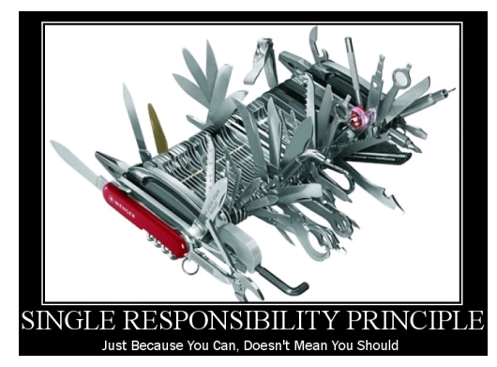
Single Responsibility Principle
"just because you can implement all the features in a single device, you shouldn't". Why? Because it adds a lot of manageability problems for you in the long run.
"There should never be more than one reason for a class to change."
Or, differently said: "A class should have one and only one responsibility".
* This principle says that if you have a class that has more than one reason to change (or has more than one overall responsibility), you need to split the class into multiple classes based upon their responsibility.
* Code becomes coupled if classes have more than one responsibility.

Slide 15
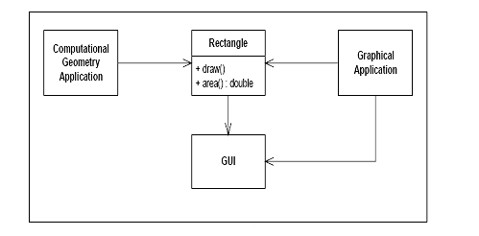
Class hierarchy showing violation of SRP principle
Here, the Rectangle class does the following:
1. It calculates the value of the rectangular area.
2. It renders the rectangle in the UI.
And, two applications are using this Rectangle class:
1. A computational geometry application uses this class to calculate the area.
2. A graphical application uses this class to draw a rectangle in the UI
Separate the responsibilities into two different classes, such as:
Rectangle: This class should define the area() method.
RectangleUI: This class should inherit the Rectangle class and define the Draw() method.

Slide 16
Advantages of SRP
Decoupled code leading to more code reuse
Smaller and clearer defined unit tests
Maintenance is easier to understand
Product evolvement is cleaner
Code readability is improved

Slide 17
Open Closed Principle
"Software entities (classes, modules, functions, etc.) should be open for extension, but closed for modification."

Slide 18
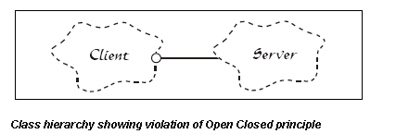
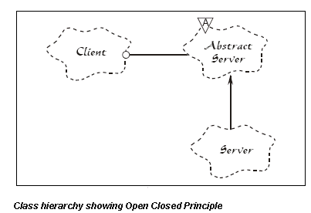
Class hierarchy showing violation of Open Closed principle
The Client and Server classes are both concrete.
So, if for any reason, the server implementation is changed, the client also needs a change.
There is an Abstract Server class added, and the client holds a reference to the abstract class, and the Concrete Server class implements the Abstract Server class.
So, if for any reason the Server implementation is changed, the Client is not likely to require any change.
The Abstract Server class here is closed for modification, and the concrete class implementations here are open for extension.

Slide 19
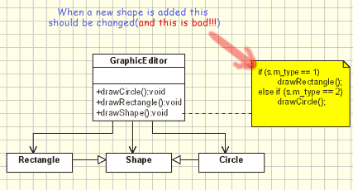
Open Closed Principle - Example

Slide 20
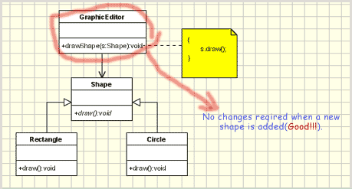
Open Closed Principle - Example

Slide 21
Open Closed principle – Bad Example
// Open-Close Principle - Bad example class GraphicEditor { public void drawShape(Shape s) { if (s.m_type==1) drawRectangle(s); else if (s.m_type==2) drawCircle(s); } public void drawCircle(Circle r) {....} public void drawRectangle(Rectangle r) {....} } class Shape { int m_type; } class Rectangle extends Shape { Rectangle() { super.m_type=1; } } class Circle extends Shape { Circle() { super.m_type=2; } }

Slide 22
Open-Close Principle - Good example
/ Open-Close Principle - Good example class GraphicEditor { public void drawShape(Shape s) { s.draw(); } } class Shape { abstract void draw(); } class Rectangle extends Shape { public void draw() { // draw the rectangle } }

Slide 23
Advantages of OCP
As you add every module as a new one no need to test the core for these extensions.
you will save yourself a lot of time in maintenance (since you don't need to track down broken Unit Tests because you did’nt change the functionality of a method)
preventing regressions.
As it is preventing a changing API which is almost impossible to keep up with. If you notice, good APIs never change. They may be extended.

Slide 24
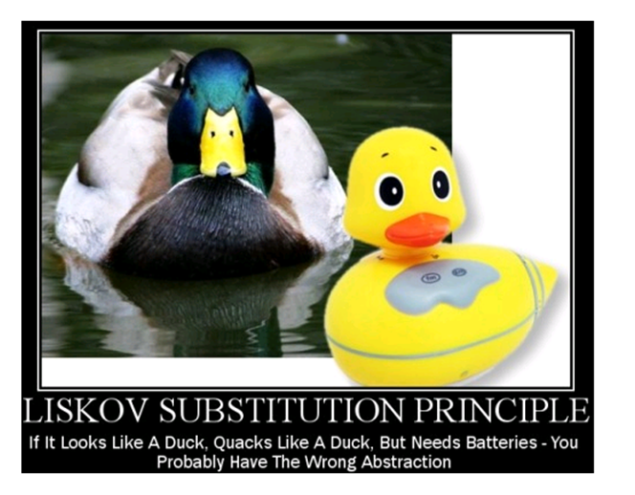
Liskov's Substitution Principle
"Subtypes must be substitutable for their base types.“
"Functions that use references to base classes must be able to use objects of derived classes without knowing it.“
The "Liskov's Substitution Principle" is just a way of ensuring that inheritance is used correctly.
If LSP is not maintained, class hierarchies would be a mess, and if a subclass instance was passed as parameter to methods, strange behaviour might occur.
If LSP is not maintained, unit tests for the base classes would never succeed for the subclass.

Slide 25
Advantages of LSP
Really shines when applied along with the Open/Closed principle.
If a class is extended into multiple sub-classes, you can still use the same code you used with the main class with these new classes.
This way you prevent dependencies and increase the ability to re-use code.

Slide 26
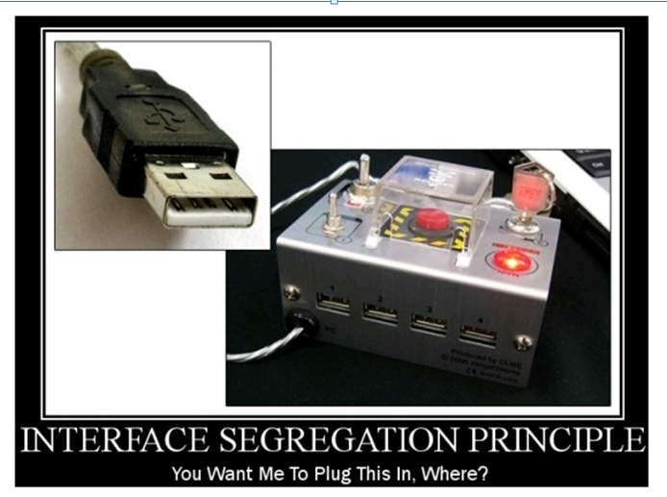
The Interface Segregation Principle
"Clients should not be forced to depend upon interfaces that they do not use.“
The Interface Segregation principle ensures that Interfaces are developed so that each of them have their own responsibility and thus they are specific, easily understandable, and re-usable.

Slide 27
Advantages of ISP
This principle is important because it encourages two very important ingredients of a good software design
High cohesion – Keep all related methods together
Low coupling – Keep dependence of one another to the bare minimum
Changes to fat interfaces tend to cause a ripple affect to classes who shouldn’t have been affected in the first place.

Slide 28
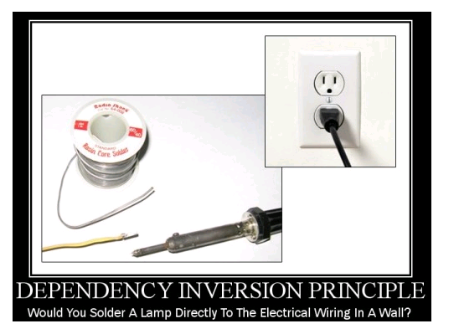
The Dependency Inversion Principle
"High level modules should not depend upon low level modules. Rather, both should depend upon abstractions."
"Abstraction" is the key for "pluggable nature"
So, if Dependency Inversion is not implemented in the code, we run the risk of:
Damaging the higher level code that uses the lower level classes.
Requiring too much time and effort to change the higher level code when a change occurs in the lower level classes.
Producing less-reusable code.

Slide 29
Advantages of DIP
There is no coupling between the three layers.
Each layer's implementation does not even need to include the header files for other layers.
You have flexibility in mixing and matching different layers. You could use the physical layer implementation with a different datalink layer. This can be accomplished without writing a single line of code in the physical layer class.
You can sandwich layers between two layers. For example, you can add a debugging layer between physical and datalink layers. This layer could trap messages between the two layers.

Slide 30
Questions?

